Slide 1
BUILDER Creational Design Pattern
Yudha Putra Arisandy
Formulatrix, Salatiga, March 22nd, 2024

Slide 2
Outline
Problem
Definition
Components
Use case
Pros & Cons

Slide 3
Problem
class Program
{
static void Main(string[] args)
{
// Without builder pattern, we directly
// instantiate the Computer object
Computer computer = new Computer();
// Set the properties manually
computer.CPU = "Intel Core i9";
computer.GPU = "NVIDIA GeForce RTX 3080";
computer.RAM = "32GB DDR4";
computer.Storage = "1TB NVMe SSD";
// Display the computer details
computer.Display();
}
}
public class Computer
{
public string CPU { get; set; }
public string GPU { get; set; }
public string RAM { get; set; }
public string Storage { get; set; }
public void Display()
{
Console.WriteLine($"CPU: {CPU}");
Console.WriteLine($"GPU: {GPU}");
Console.WriteLine($"RAM: {RAM}");
Console.WriteLine($"Storage: {Storage}");
}
}

Slide 4
Problem
class Program
{
static void Main(string[] args)
{
// Create a gaming computer
Computer gamingComputer = new Computer();
gamingComputer.CPU = "Intel Core i9";
gamingComputer.GPU = "NVIDIA GeForce RTX 3080";
gamingComputer.RAM = "32GB DDR4";
gamingComputer.Storage = "1TB NVMe SSD";
Console.WriteLine("Gaming Computer:");
gamingComputer.Display();
Console.WriteLine();
// Create an office computer
Computer officeComputer = new Computer();
officeComputer.CPU = "Intel Core i5";
officeComputer.GPU = "Integrated Intel Graphics";
officeComputer.RAM = "16GB DDR4";
officeComputer.Storage = "500GB SSD";
Console.WriteLine("Office Computer:");
officeComputer.Display();
}
}

Slide 5
Definition
Creational design pattern
A type of software design pattern that deal with the instantiation process of creating objects in a software application.
The goal: To ensure that the process of creating objects is easy to maintain and extend in the future.
Two main categories:
Single step object creation
Ex: Factory Method and Singleton patterns
Multi steps object creation
Ex: Builder and Prototype patterns.

Slide 6
Definition (2)
Builder: creational design pattern that lets you construct complex objects step by step.
Allows to produce different types and representations of an object using the same construction code.
Flexibility
Reuse of existing code

Slide 7
Components
Main Program
Interface
Builder
Product
Builder
Director
Object that will be built
Contains:
- Blueprint1
- Blueprint2,
- Blueprint3,
…
Manufacturer
Director

Slide 8
Use Case
Builder
// Builder interface
public interface IComputerBuilder{
void BuildCPU();
void BuildGPU();
void BuildRAM();
void BuildStorage();
Computer GetComputer();
}
Product
// Product class
public class Computer{
public string CPU { get; set; }
public string GPU { get; set; }
public string RAM { get; set; }
public string Storage { get; set; }
public void Display(){
Console.WriteLine($"CPU: {CPU}");
Console.WriteLine($"GPU: {GPU}");
Console.WriteLine($"RAM: {RAM}");
Console.WriteLine($"Storage: {Storage}");
}
}
// Concrete builders
public class GamingComputerBuilder : IComputerBuilder{
private Computer _computer = new Computer();
public void BuildCPU(){
_computer.CPU = "Intel Core i9";}
public void BuildGPU(){
_computer.GPU = "NVIDIA GeForce RTX 3080";}
public void BuildRAM(){
_computer.RAM = "32GB DDR4";}
public void BuildStorage(){
_computer.Storage = "1TB NVMe SSD";}
public Computer GetComputer(){
return _computer;}
}

Slide 9
Use Case
Director
// Director class
public class ComputerManufacturer{
private readonly IComputerBuilder _builder;
public ComputerManufacturer(IComputerBuilder builder){
_builder = builder;}
public void AssembleComputer(){
_builder.BuildCPU();
_builder.BuildGPU();
_builder.BuildRAM();
_builder.BuildStorage();}
}
class Program
{
static void Main(string[] args)
{
// Build a gaming computer
var gamingComputerBuilder = new GamingComputerBuilder();
var gamingManufacturer = new ComputerManufacturer(gamingComputerBuilder);
gamingManufacturer.AssembleComputer();
var gamingComputer = gamingComputerBuilder.GetComputer();
Console.WriteLine("Gaming Computer:");
gamingComputer.Display();
}
}

Slide 10
Pros & Cons
Pros
Encapsulation
Single Responsibility Principle
Cons:
Increase code complexity
Performance overhead
Notes:
Encapsulation: Builders encapsulate the construction process, hiding the details of object creation from the client code. This promotes loose coupling between the client and the constructed object, as the client does not need to know the specifics of how the object is built.
Single Responsibility Principle: by separating the construction process of complex objects into dedicated builder classes, ensuring that each class has a single responsibility: constructing a specific type of object or variation.
Increased Complexity: Implementing the Builder pattern can introduce additional complexity to the codebase, especially if the object being built has a large number of optional parameters or a complex initialization process. This complexity may make the code harder to understand for developers who are not familiar with the pattern.
Performance Overhead: Using a Builder can introduce a slight performance overhead compared to directly constructing objects, as it involves additional method calls and object creations. While this overhead is usually negligible in most applications, it might be a concern in performance-critical systems.

Slide 11
Supplementary Materials

Slide 12
References
Head First Design Patterns
Design Pattern : https://docs.google.com/document/d/1B79XMGp4a6nDDhRnx-fSKIkPrn11i7U_vumdkqNf0WU/edit
Creational Design Pattern : https://docs.google.com/document/d/1LSTLK4IR8glcU5tEZiKxf4tmxRXHMp0TCE8Z9kF8bkg/edit
C#3.0 Design Patterns - Judith Bishop
RefactoringGuru or Deep Dive into Design Patterns

Slide 13
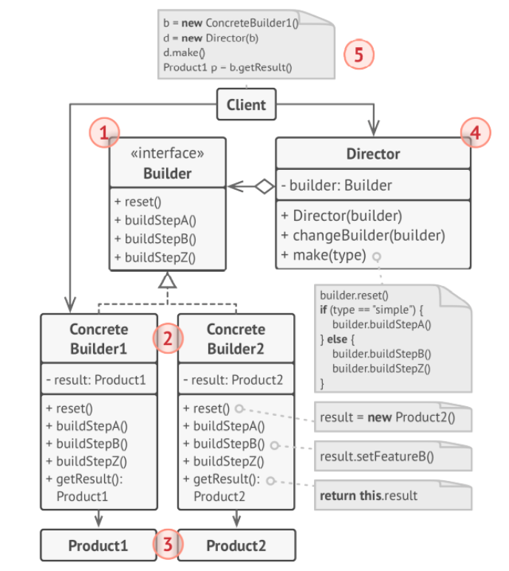
Creating Builder Design Pattern
Builder interface declares product construction steps
Concrete Builder provide different implementation
Products is result of object
Director defines the order in which to call construction steps, so you can create and reuse specific configurations
Client must associate one of the builder objects with the director

Slide 14
Function of Builder Design Pattern
Function:
The function of Builder is to provide flexible solution to various object creation problems in OOP. It separates construction of complex object from it representation, so same construction process can create different representation.
Builder builds complex object using simple object.
The reason builder needed:

Slide 15
Definition of Design Pattern
high-level concepts.
Are reusable solutions to commonly occurring problems in software design.
Represent best practices and provide a template or blueprint for structuring code to solve particular design problems in a consistent and efficient manner.
Help developers communicate more effectively
by providing a common language to discuss and understand design concepts.
Promote code reusability, maintainability, and scalability.

Slide 16
Creating Builder Design Pattern (3)
Conclusion of step by step :
Create an interface with methods that define the steps to create an object.
Create one or more classes that implement the interface.
Create a director class that uses the builder interface to create an object, but is unaware of the implementation details.
Use the director class to manage the construction process of the object.
Call the appropriate methods of the builder object in the director class to create the object.
When the object is fully constructed, call the appropriate method of the builder object to retrieve the object.

Slide 17
Definition of Design Pattern (2)
Categories:
Creational Patterns: These patterns deal with object creation mechanisms, abstracting the instantiation process. Examples include Singleton, Factory Method, Abstract Factory, Builder, Prototype, etc.
Structural Patterns: Structural patterns focus on how classes and objects are composed to form larger structures. Examples include Adapter, Bridge, Composite, Decorator, Facade, Proxy, etc.
Behavioral Patterns: Behavioral patterns are concerned with algorithms and the assignment of responsibilities between objects. Examples include Observer, Strategy, Command, Iterator, Visitor, Chain of Responsibility, State, Memento, etc.

Slide 18
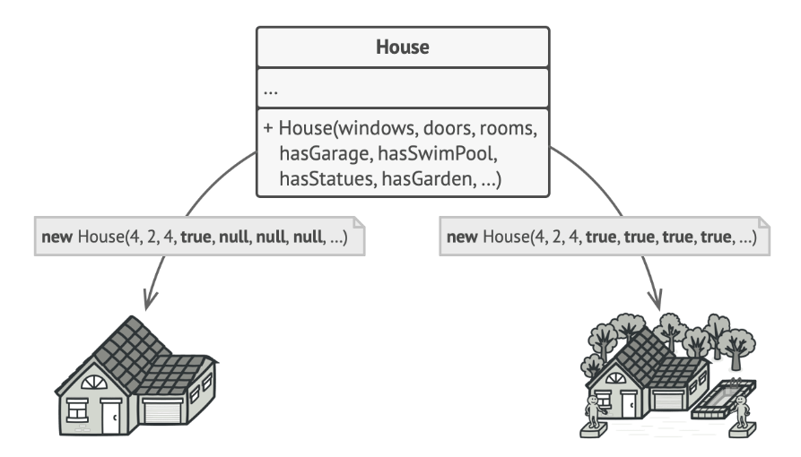
Definition of Builder Design Pattern
How to create the code:
Create many subclasses with additional properties.
Create only one class “House” with a lot of parameters in Constructor.
The constructor with lots of parameters has its downside: not all the parameters are needed at all times.

Slide 19
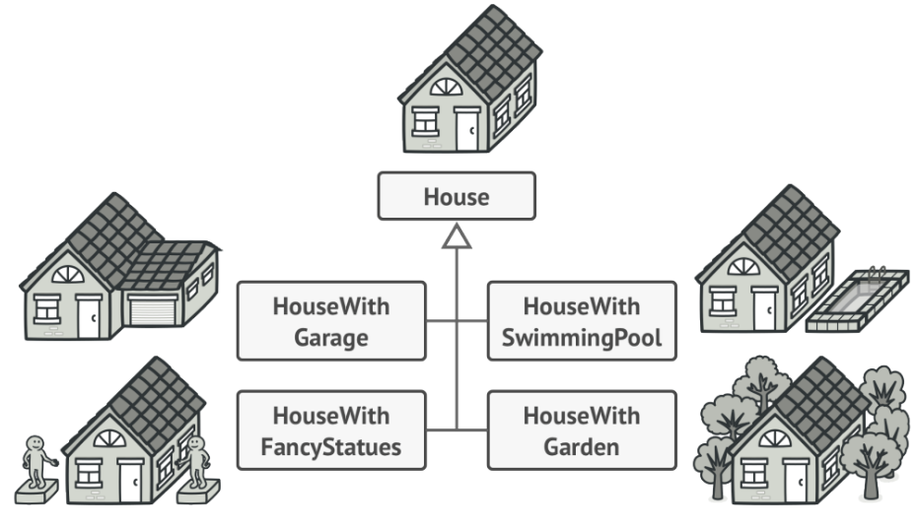
Definition of Builder Design Pattern
How to create the code:
Create many subclasses with additional properties.
Create only one class “House” with a lot of parameters in Constructor.
You might make the program too complex by creating a subclass for every possible configuration of an object.

Slide 20
Notes – Prototype design pattern
Creational design pattern.
Increse flexibility in object creation
Steps:
Create by cloning a stored prototype
Ability to copy object without depend on a product class
Problem:
We need to know the exact variables list from a product class to be copied.
Manual copy: Can’t create private variable in the main.cs
Solution:
Delegates the cloning process to the actual object
Implementation:
Interface prototype (have Clone()) -> IClonable
Define alternative constructor (accept an object itself)
Client input -> Prototype registry (cloneMachine) -> cloning from here.

Slide 21
Notes – Factory Method Design Pattern
Creational design pattern
Use case: implementasi objek tanpa tahu class-nya apa.
Implementasi:
Icreator -> concrete
Iproduct -> concrete

Slide 22
Notes – Singleton
Creational Design Pattern
One global instance
Sebuah class yang punya instance in itself
Other classes use the instance by calling get method
No public constructor -> only private constructor

Slide 23
Notes – Adapter Design Pattern
Connect a class which is not compatible with another class.

